Slide 1
WEEK 1

Slide 2
MARKETING (1)
‘The management process responsible for identifying, anticipating and satisfying customer requirements profitably.’ (The Chartered Institute of Marketing)
Marketing is a social and managerial process by which individuals and groups obtain what they need and want through creating and exchanging products and value with others.
(Kotler, Armstrong, Saunders and Wong, 2001: 5)

Slide 3
MARKETING (2)
Marketing is the process of planning and executing the conception, pricing, promotion, and distribution of ideas, goods, and services to create exchanges that satisfy individual and organizational objectives.
(The American Marketing Association)

Slide 4
MARKETING (3)
Core Marketing Concepts
Needs, wants & demand
Products
Core
Marketing
Concepts
Markets
Values, satisfaction & quality
Exchange transactions & relationship

Slide 5
MARKETING (4)
More simply,
Marketing is all about satisfying needs & wants.
NEEDS:
State of felt deprivation including physical needs for food, social needs for belonging and individual needs for self-expression.
i.e. I am thirsty.
WANTS:
Form that a human need takes as shaped by culture and individual personality.
i.e. I want a Coca-Cola.

Slide 6
MARKETING (5)
PRODUCT:
Anything that can be offered to a market for attention, acquisition, use or consumption that might satisfy a want or need. It includes physical objects, services, persons, places, organizations, and ideas.
SERVICE:
Any activity or benefit that one party to another that is essentially intangible and does not result in the ownership of any thing.

Slide 7
MARKETING (6)
VALUE:
Value is the consumer’s assessment of the product’s overall capacity to satisfy his/her needs.
SATISFACTION:
Satisfaction is the extent to which a product’s perceived performance matches a buyer’s expectations. If the product's performance fall short of expectations, the buyer is dissatisfied. If performance matches or exceeds expectations, the buyer is satisfied or delighted.
QUALITY:
Quality is defined by American Society of Quality Control as the totality of features and characteristics of a good or service that bear on its ability to satisfy needs. (TQM)

Slide 8
MARKETING (7)
Exchange, Transaction & Relationship:
Marketing occurs when people decide to satisfy needs and wants through exchange relationships.
Exchange is an act of obtaining a desired object from someone by offering something in return.

Slide 9
MARKETING (8)
MARKETS:
The set of all actual and potential buyers of a product or service.
A simple marketing system
Industry
(a collection of sellers)
Products-services
Industry
(a collection of sellers)
Market
(a collection of buyers)
Money

Slide 10
MARKETING (9)
Industry
(a collection of sellers)
Products-services
Industry
(a collection of sellers)
Market
(a collection of buyers)
Money
Information
Suppliers
Company
(Markets)
Marketing
Intermediaries
End user
Market
Company
(Markets)
Main actors & forces in a modern marketing system

Slide 11
Marketing Management
MARKETING MANAGEMENT:
The analysis, planning, implementation, and control of programs designed to create, build and maintain beneficial exchanges with target buyers for the purpose of achieving organizational objectives.
Thus marketing management involves managing demand, which in turn involves managing customer relationship.
DEMAND MANAGEMENT (Demarketing)
BUILDING PROFITABLE CUSTOMER RELATIONSHIP

Slide 12
MARKETING MANAGEMENT PHILOSOPHIES
PRODUCTION ORIENTATION
SLAES ORIENTATION
MARKETING ORIENTATION
This era was characterised by the focus of company efforts on producing a good or service. More specifically, management efforts were devoted to achieving high production efficiency, often through the large-scale production of standardised items.
Sales, finance and personnel were seen as secondary.
The underlying philosophy towards customers was that they would purchase the products, provided that they were available in sufficiently large quantities of a suitably low price.
The sales oriented company is one where the focus of company efforts switches to the sales function. The main issue here is not how to produce but, having products, how to ensure that this production is sold. The primary focus is on sales.
‘The idea that customers will not buy enough of the organization’s products unless the organization undertakes a large-scale selling and promotion effort.’
The concept is typically practiced with unsought goods – those that buyers do not normally think of buying, such as insurance, encyclopaedias etc.
The marketing concept holds that the key to successful and profitable business rests with identifying the needs and wants of customer and providing products and services to satisfy these needs and wants.
Increasingly, companies have come to recognise that this different approach to doing business is essential in today’s environment. Consumers are now better educated and more sophisticated than they were.
Businesses should be Marketing Orientated. Customer needs, wants and requirements should be identified and offered to the consumer.

Slide 13
MARKETING MANAGEMENT PHILOSOPHIES
Production
Sales
Customers
Emphasis on seller’s needs
a) Sales orientation
Customer needs
Production
Sales
Emphasis on customer’s needs
b) Marketing orientation

Slide 14
NEW MARKETING MANAGEMENT PHILOSOPHY
The idea that the organization should determine the need, wants, and interests of target markets and delivered the desired satisfaction more effectively and efficiently than do competitors in a way that maintains or improves the consumer’s and society’s well being.
Society
(Human welfare)
Consumers
(Want satisfaction)
Company
(profits)

Slide 15
WEEK 2

Slide 16
Marketing Research
    Marketing research is the function that links the consumer, customer, and public to the marketer through information--information used to identify and define marketing opportunities and problems; generate, refine, and evaluate marketing actions; monitor marketing performance; and improve understanding of marketing as a process. Marketing research specifies the information required to address these issues, designs the method for collecting information, manages and implements the data collection process, analyzes the results, and communicates the findings and their implications. (AMA)

Slide 17
The Marketing Research Process
Defining the
problem and
research
objectives
Developing the
research plan
for collecting
information
Implementing
the research
plan -- collecting
and analyzing
the data
Interpreting
and reporting
the findings

Slide 18
Marketing Research 1
    Defining the problem and research objectives
        Exploratory research
        Gathering preliminary information that will help to better define problems and suggest hypotheses.
        Descriptive research
        Defining marketing problems, situations or markets, such as the market potential for a product or the demographics and attitudes of consumers.
        Causal research
        Marketing research to test hypotheses about cause and effect relationships.

Slide 19
Marketing Research 2
    Developing the research plan for collection of information
      Determining information needs
        Secondary data: information that already exists, having been collected for another purpose.
        Primary data: information collected for the specific purpose at hand.
        Qualitative research
        Exploratory research used to uncover consumers’ motivations, attitudes and behaviour.
        Quantitative research
        Research data which involves interviews from a sufficient volume of customers to allow statistical analysis.

Slide 20
Marketing Research 3
    Presenting the research plan
      Outline of research construct.
      Summarised written proposal.

Slide 21
Marketing Research 4
    Implementing the research plan, collecting and analysing the data
    Interpreting and reporting the findings.
      Present the relevant data so that the information can be used to make meaningful decisions.
      Team effort between marketers and researchers and joint responsibility.

Slide 22
Why Plan?
If you fail to plan, you are planning to fail.

Slide 23
Marketing Planning

Slide 24
Marketing Planning
Marketing Planning (is) a process of strategically analysing environmental, competitive and business factors affecting business units and forecasting future trends in business areas of interest to the enterprise. Participating in setting business objectives and formulating corporate and business unit strategy. Selecting target market strategies for; the product-markets in each business unit, establishing marketing objectives, and developing, implementing and managing program positioning strategies for meeting target market needs. Cravens (in Fiefield et al 2000)

Slide 25
From Corporate to Functional Planning; understanding the three levels
Markets which the
organisation wishes
to compete in.
Corporate Level Planning
The businesses it will
compete within the
chosen market.
Business Level Planning
The functional
strategies of finance,
manufacturing,
marketing, HRM.
Functional Level Planning

Slide 26
Strategic Planning
Strategic Planning is the Process of Developing and Maintaining a Strategic Fit Between the Organization’s Goals and Capabilities and Its Changing Marketing Opportunities.

Slide 27
Steps in Strategic Planning
Business unit,
product,
and market
level
Corporate Level
Planning,
marketing,
and other
functional
Strategies
Defining the
Company
Mission
Setting Company
Objectives
and Goals
Designing
the Business
Portfolio

Slide 28
3 Major types of plans
The Annual Plan
  Short-term, describing the company’s current situation, its objectives, the strategy, action programme and budgets for the year ahead, and controls
The Long-Range Plan
  Describes the principal factors and forces affecting the organisation during the next several years, including long-term objectives, strategies and the resources required.
The Strategic Plan
  Describes how a firm will adapt to take advantage of opportunities in its constantly changing environment.
  Maintains a strategic fit between the firm’s goals and capabilities and its changing market opportunities.

Slide 29
Portfolio Analysis
The business portfolio:
  The collection of businesses and products that make up the company
Portfolio analysis:
  Step 1:
  Analyse the current business portfolio
  Step 2:
  Shape the future business portfolio

Slide 30
WEEK 3

Slide 31
Marketing Planning
S.O.S.T.A.C
S Situation Analysis - where are we now?
O Objectives - where do we want to go?
S Strategy - how do we get there – broad direction?
T Tactics - how do we get there - details of strategies (individual tactical tools)?
A Action - putting the plan to work - what are the specific actions required for each individual tactical step?
C Control - how do we know we have arrived? - measurement, monitoring, reviewing, updating and modifying.

Slide 32
3 M’s
M Men/Women Human Resource
People’s expertise and ability to do different jobs.
M Minutes means Time
What are the time scales, schedules or deadlines?
Is there enough time?
M Money means Budget
Have you got the money?
How much will it cost?

Slide 33
Marketing Planning S.O.S.T.A.C
S Situation Analysis
where are we now?
Market Research
Internal Analysis
External Analysis
  The Company’s Microenvironment
  The Company’s Macroenvironment

Slide 34
Situation Analysis (1)
where are we now?
  swot.ppt
INTERNAL ANALYSIS
INTERNAL ANALYSIS
  Mission Statement
  Sales & Market Share
  Profitability
  Customers‘ Loyalty
  PLC
  Michenzy Matrix
  Targeting & Positioning
  7 P‘s
  STRENGTHS
  WEAKNESSES
MICRO
MACRO
  Structure of Industry, stakeholders
  Market trends
  Power forces
  (Porter‘s Five Forces Model)
  Social
  Technological
  Economical
  (Macro)
  Political
  OPPORTUNITIES
  THREATS

Slide 35

MISSION STATEMENT
Defining the Company’s Business & Mission (1)
Market Oriented
A Mission Statement is a Statement of the Organization’s Purpose.
Realistic
Characteristics of a Good Mission Statement:
Fit Market Environment
Specific
Distinctive Competencies
Motivating

Slide 36



MISSION STATEMENT
Defining the Company’s Business & Mission (2)
Limited number of goals
Stress major policies & values
Define competitive scopes

Slide 37
Internal Marketing Environment
Internal Environment- includes the organisation and its performance. It looks at key performance indicators, like sales market share, profitability, customer loyalty scores, number of new product etc.
The performance should be measured over time that is over a period of years. This allows the organisation to see the trend - whether things are improving or declining.

Slide 38
Product Life Cycle
Sales and Profits Over the Product’s Life From Introduction to Decline
Sales and
Profits ($)
Sales
Profits
Time
Product
Develop-
ment
Introduction
Growth
Maturity
Decline
Losses/
Investments ($)

Slide 39
Market Attractiveness
Competitive- Position Portfolio Classification
BUSINESS STRENGTH
Strong
Medium
Weak
5.00
3.67
2.33
1.00
5.00
High
3.67
MARKET ATTRACTIVENESS
Medium
2.33
Low
1.00
Invest/grow
Selectivity/earnings
Harvest/divest

Slide 40
External Marketing Environment
External Marketing Environment- consists of the actors and forces outside marketing that affect marketing management’s ability to develop and maintain successful relationships with its target customers.
Includes:
  Microenvironment - forces close to the company that affect its ability to serve its customers.
  Macroenvironment - larger societal forces that affect the whole microenvironment.

Slide 41
External Marketing Environment
Sociocultural
Structure of the market & stakeholders
Political / legal
Company
Power forces
Trends of the market
Economic
Economics (micro)
Technological

Slide 42
The Microenvironment
S.T.E.P. 1
  Structure of the market & stakeholders
  Trends of the market
Forces affecting a company
  Power forces
  Economics (Micro)

Slide 43
Structure of the market & stakeholders
Degree of concentration and fragmentation of the market (monopoly, oligopoly, perfect or monopolistic competition).
Competitors - those who serve a target market with similar products and services against whom a company must gain strategic advantage.
Extend and effectiveness of entry barriers.
How can market share / profitability be maintained and developed.
Effective buyer and suppliers relationships.
Effective buyer and intermediaries relationships.
Effective relationship with other publics (stockholders, creditors, communities, employees/labor unions).

Slide 44
Trends of the market
How, where do consumers purchase.
Amount and frequency of purchase.
Changing demographic profiles of existing and potential target markets.
Changing segmentation criteria.
Changing consumer attitudes, opinions and interests.
Customer perceptions of the market, organisation, product competitors.

Slide 45
Economics (Micro)
Determinants of profitability
Sales volume
Pricing policies
Discount policies
Expenditure analysis
Cost structures
Levels of productivity
Financial strength and liquidity

Slide 46
Power Forces
Potential Entrants
Threat of entrants
Supplier Power
Bargaining power
Competitive Rivalry
Buyer Power
Bargaining power
Substitutes
Threat of substitutes
Figure: The five forces
Source: Porter M. (1985)

Slide 47
The Macroenvironment
S.T.E.P. 2
  Socioculture
  Technological
Forces-shape opportunities & poses threats
  Political
  Economics (Macro)

Slide 48
The Macroenvironment
S.T.E.P. 2
Sociocultural - institutions and other forces that affect a society’s basic values, perceptions, preferences, and behaviors.
Technological - forces that create new technologies, creating new product and market opportunities.
Economic - factors that affect consumer purchasing power and spending patterns.
Political - laws, agencies and groups that influence and limit organizations and individuals in a given society.

Slide 49
WEEK 4

Slide 50
Consumer Buying Behavior
Defined as the buying behaviour of the final consumers, individuals and households who buy goods and services for personal consumption.
Consumer Market
Consumer market is defined as all the individuals and households who buy or acquire goods and services for personal consumption.
The world consumer market consists of approx 6.3 billion people
  the billion people in North America, Western Europe and Japan make up 70% of the world’s spending power.

Slide 51
Influencers of consumer behaviour 1
Cultural factors
  Culture
  Subculture
  Social class
Social factors
  Family, Friends, Religious groups, Professional groups etc.
Personal factors
  Age
  Occupation
  Lifestyle
Psychological factors
  Motivation
  Learning
  Beliefs & attitude

Slide 52
Problem Recognition / Need Identification
Information Search/Gathering
Evaluation of Alternatives
The Buyers Decision Process
Selection of Appropriate Solution (Product Choice)
Postpurchase Evaluation

Slide 53
The Buyers Decision Process 1
Problem/Need Recognition
Need Recognition
Buyer Recognizes a Problem or Need
Internal Stimuli
Hunger
Thirst
A person’s normal needs
(see hierarchy of needs
of Abraham Maslow)
External Stimuli
TV advertising
Magazine ad
Radio slogan
Stimuli in the environment

Slide 54
Maslow’s Hierarchy of Needs
Upper-Level Needs
Self
Actualization
Self-fulfillment
Ego Needs
Prestige, status
Belongingness
Love, friendship, acceptance by others
Safety
Security, shelter, protection
Physiological
water, sleep, food
Lower-Level Needs

Slide 55
The Buyers Decision Process 2
Personal Sources
Information Search
Commercial Sources
Family, friends, neighbors
Most effective source of
information
Public Sources
Advertising, salespeople
Receives most information from
these sources
Experiential Sources
Mass Media
Consumer-rating groups
Handling the product
Examining the product
Using the product

Slide 56
The Buyers Decision Process 3
Evaluation of Alternatives
Possible Cars
Toyota Corolla
Mazda 323
Honda Civic
Evaluative Criteria
Price
Gas mileage
Roominess
Color & Design

Slide 57
The Buyers Decision Process 4
Product Choice
Purchase Intention
Desire to buy the most preferred brand
Brand
Loyalty &
Attitude to others
Country-of-
Origin
& Other Personal Factors
Purchase Decision

Slide 58
The Buyers Decision Process 5
Post-purchase Evaluation
Consumer’s Expectations of
Product Quality and Performance
Product’s Perceived Performance Standard
Satisfied Customer!
Dissatisfied Customer

Slide 59
Stages in the adoption process
for new products
Awareness
Interest
Evaluation
Trial
Adoption

Slide 60
Marketing Planning S.O.S.T.A.C
O Objectives
where do we want to go?
Objectives represents a statement of what the organisation is trying to achieve. The guidelines for setting worthwhile objectives are straightforward and highlight the need for them to be quantifiable, mutually consistent, realistic and related to a specific timescale. (Fiefield and Gilligan 2000)

Slide 61
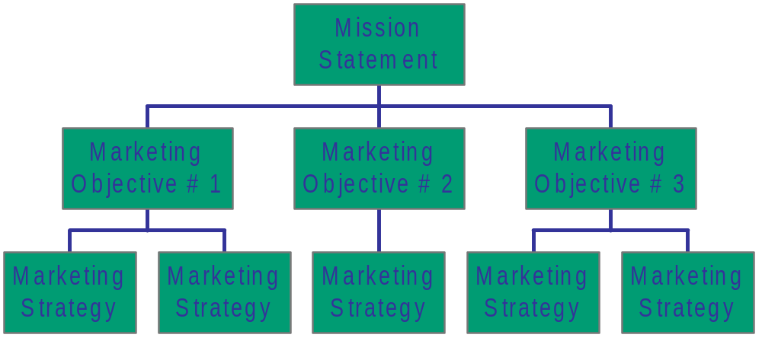
O Objectives
where do we want to go?

Slide 62
Types of Objectives
In Marketing Plan
Marketing Objectives
Communication Objectives
  …
  …
Sales & market share
Product/brand profitability
New product development
Number of new products launched
Outlet/distribution penetration
Customer reaction
Customer retention
Communication Model
AIDA
A Awareness/Attention
I Interest
D Desire
A Action

Slide 63
Marketing Objectives Criteria
Objectives should be S.M.A.R.T.
Specific
Measurable
Achievable
Realistic
Time related

Slide 64
Objectives Examples
To increase market share by 3% by the end of 2005.
To gain 5% of the youth market in two years
To increase product awareness by 35% by the end of this year.

Slide 65
WEEK 5

Slide 66
Marketing Planning S.O.S.T.A.C
S Strategies
how do we get there – broad direction?
Marketing strategies are the means by which objectives will be achieved. It reflects the company’s best opinion as to how it can most profitably apply its skills and resources in the marketplace. It is inevitably broad in scope. Strategy is a decision which will affect all the subsequent tactical details.
Tactics are driven by strategy.

Slide 67
S Strategies
how do we get there – broad direction?
Marketing strategy is the broad statement of the way in which the organisation sets out to achieve these objectives. Included within this would be a series of decisions on the markets in which the organisation will operate, the type of products/services it will offer and the basis of the competitive stance.
Effectiveness & Efficiency
Effective: Doing the right thing? Having the desired effect. Producing the intended results.
Efficient: Doing the things right? Able to work well and without wasting time or resources.

Slide 68
S Strategies 2
how do we get there – broad direction?
Segmentation, Targeting & Positioning
Target marketing
  Identifies market segments that are bite sized chunks that organisations can manage.
Market segmentation
  Identifies markets with common traits.
Market targeting
  Process of evaluation of the selected segments and then deciding which market segments to operate within
Market positioning
  Process whereby marketers position the product to occupy a clear and distinctive position relative to other competing products.

Slide 69
S Strategies 3
how do we get there – broad direction?
The need for market segmentation
Marketers understand that they cannot be all things to all people, all of the time. Buyers and markets are too complex and diverse for one simple marketing formula to adequately address the needs of all.
Markets are comprised of buyers and they differ in wants, resources, locations and buying patterns.
Market segmentation is the process that marketers use to divide up the market into smaller segments that can be efficiently addressed.

Slide 70
S Strategies 4
how do we get there – broad direction?
The need for market segmentation
Marketers understand that they cannot be all things to all people, all of the time. Buyers and markets are too complex and diverse for one simple marketing formula to adequately address the needs of all.
Markets are comprised of buyers and they differ in wants, resources, locations and buying patterns.
Market segmentation is the process that marketers use to divide up the market into smaller segments that can be efficiently addressed.

Slide 71

S Strategies 5
how do we get there – broad direction?
Market segmentation involves aggregating prospective buyers into groups that:
1. Have common needs and
2. Will respond similarly to the marketing action.
The groups that result from the
market segmentation process are
called market segments, a relatively
homogeneous collection of prospective buyers.

Slide 72
Market Segmentation 1
Levels of market segmentation
  Mass marketing
    Assumes market is homogenous and uses the same product, promotion and distribution to all consumers.
  Segment marketing
    Adapting a company’s offerings so they more closely match the needs of one or more segments.
  Niche marketing
    Adapting a company’s offerings to match the needs of one or more sub-segments more closely where there is little competition.
  Micro marketing
    Marketing programmes tailored to narrowly defined geographic, demographic, psychographic behavioural segments.

Slide 73
Micro marketing
Market Segmentation 2
      Local Marketing
        Tailoring brands and promotions to the needs and wants of local customer groups.
      Individual marketing
        Tailoring products and marketing programmes to the needs and preferences of individual customers.
      Mass customisation
        Preparing individually designed products and communication on a large scale.
There is no single way of segmenting a market.
Different market segmentation variables to develop the most effective segmentation method.
Major variables used are geographic, demographic, psychographic and behavioural.

Slide 74
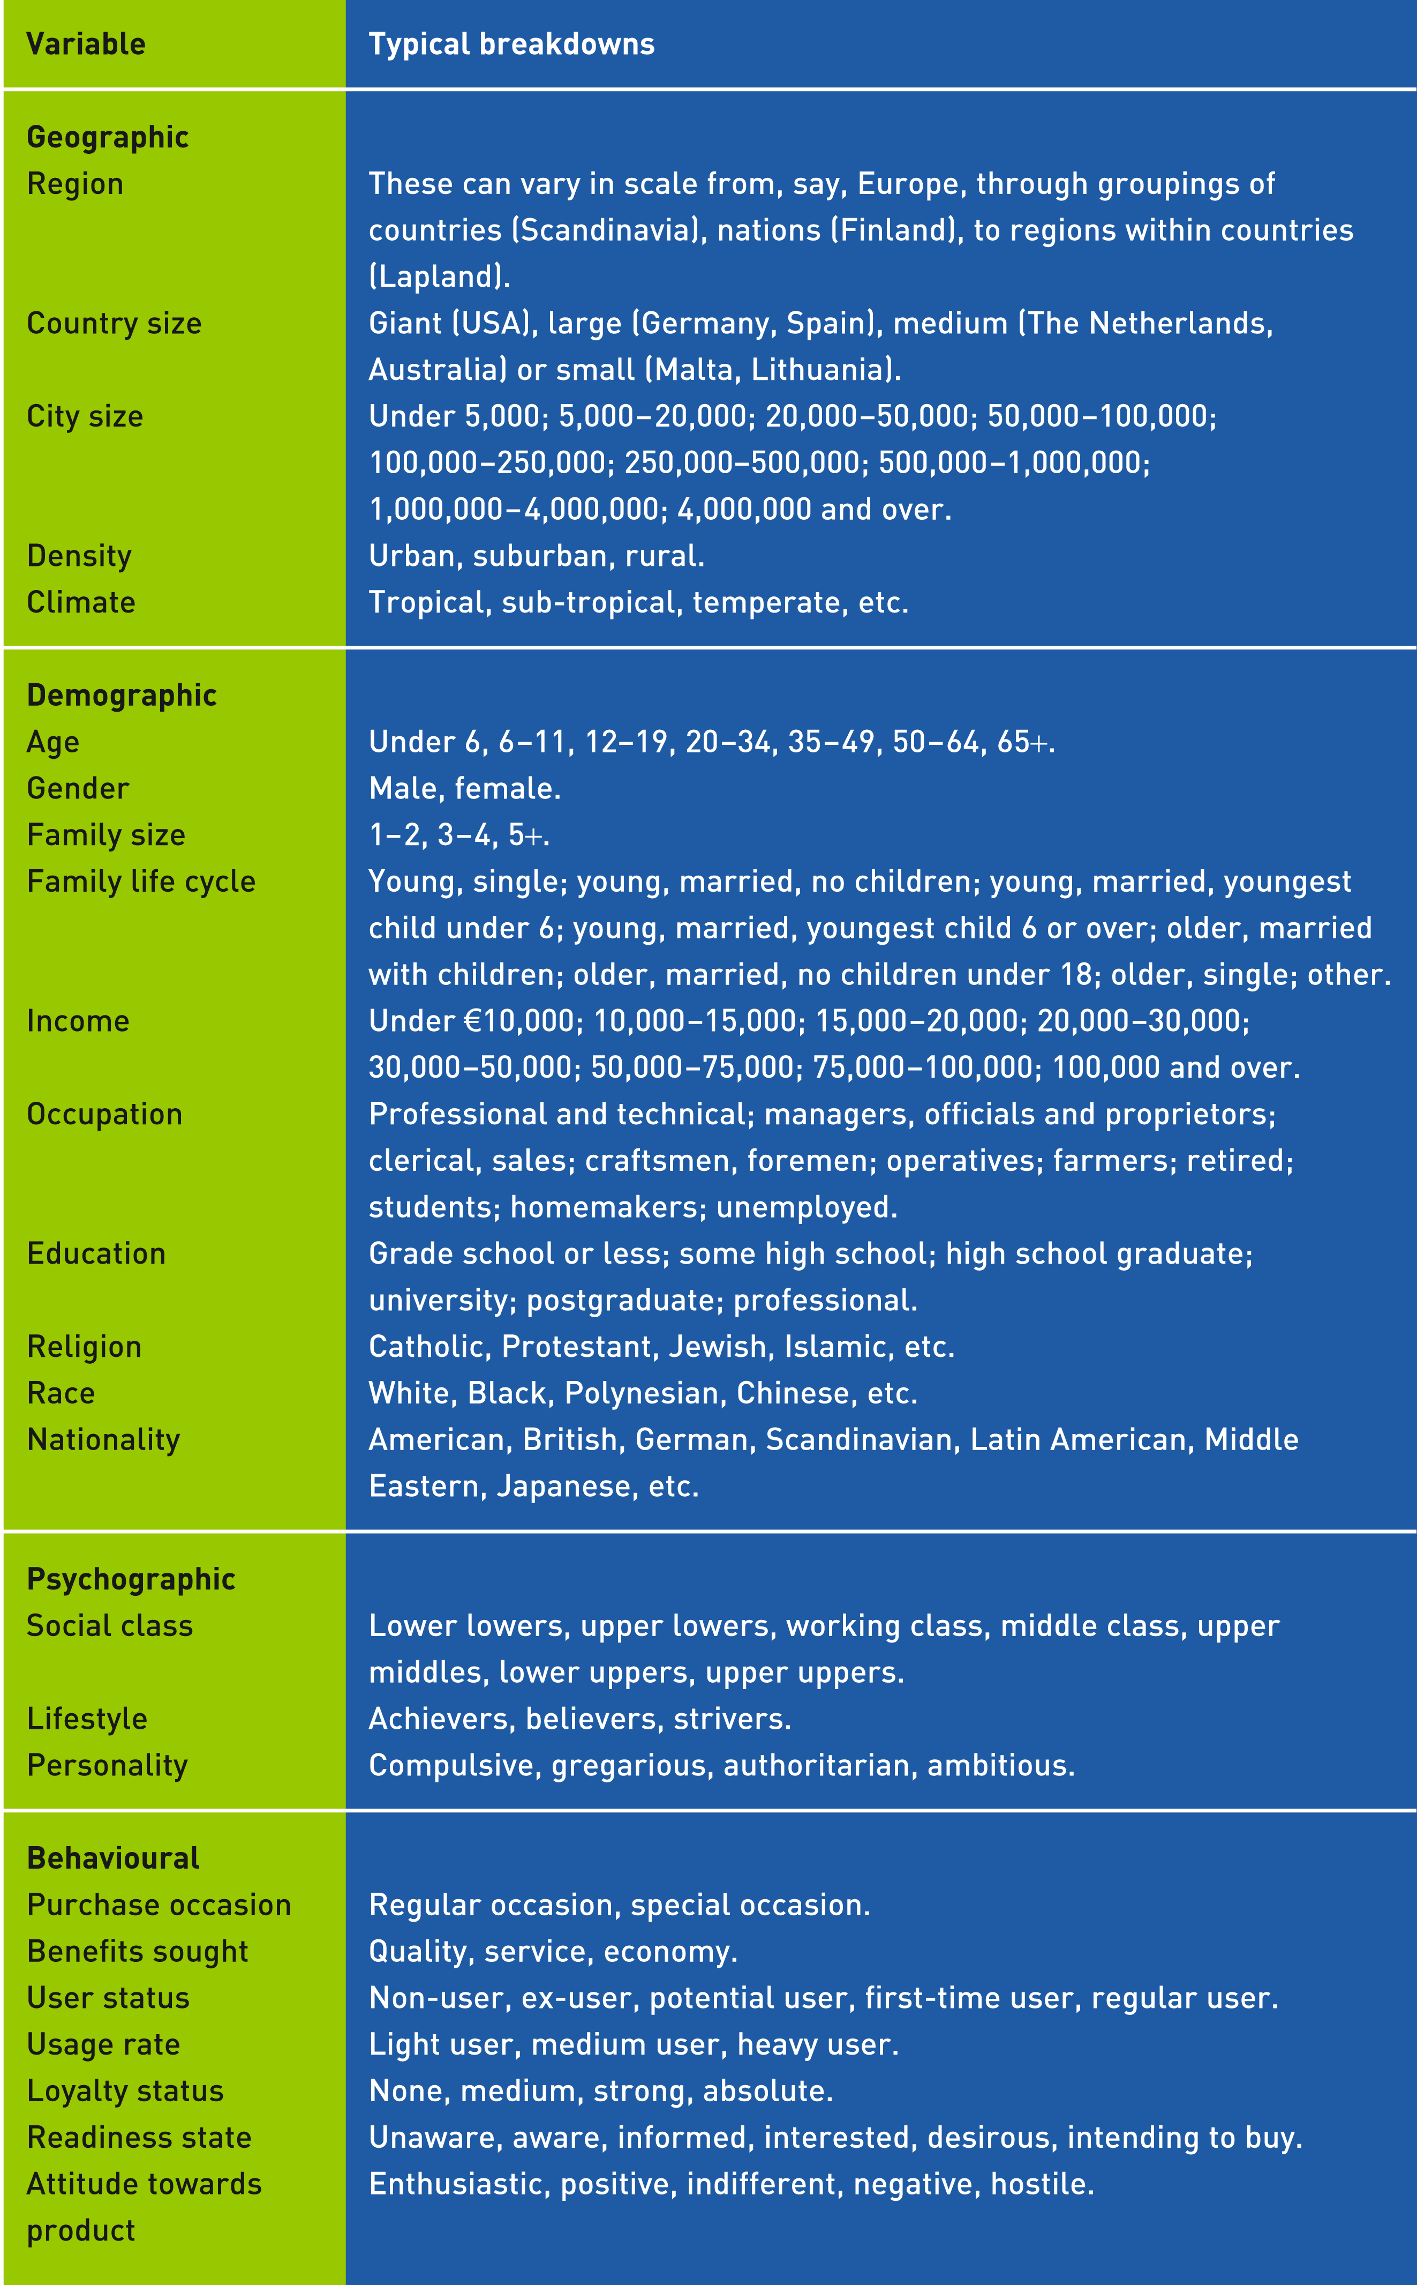
Market Segmentation 3
Table 10.1 Market segmentation
variables for consumer markets

Slide 75
Market Segmentation 5
Geographic segmentation
  Dividing a market into different geographical units such as countries, states, regions, towns.
Demographic segmentation
  Age and life-cycle segmentation.
  Ethnic segmentation.
  Gender segmentation.
  Income segmentation.
Geo-demographics
  Study of relationship between geographical location and demographics.
Psychographic segmentation
  Social class
  Lifestyle
  Personality traits
Behavioural segmentation
  Markets segmented based upon consumer knowledge, attitude, use or response to a product.
    Occasion segmentation, Benefit segmentation, User status
    Usage rate, Loyalty status, Buyer readiness stage ,Attitude towards product

Slide 76
Measurable
Requirements for effective segmentation
Accessible
Substantial
Size, purchasing power, profiles
of segments can be measured.
Differential
Segments can be effectively
reached and served.
Actionable
Segments are large or profitable enough to serve.
Segments must respond differently to different marketing mix elements & programs.
Effective programs can be designed to attract and serve the segments.

Slide 77
S Strategies 6
how do we get there – broad direction?
Market targeting involves evaluating marketing segments:
Segment Size and Growth
  Analyze current sales, growth rates and expected profitability for various segments.
Segment Structural Attractiveness
  Consider effects of: competitors, availability of substitute products and, the power of buyers & suppliers.
Company Objectives and Resources
  Company skills & resources needed to succeed in that segment(s).
  Look for Competitive Advantages.

Slide 78
Market Targeting 1
Company
Marketing
Mix
Market coverage strategies
Market
Company
Marketing Mix 1
Segment 1
Company
Marketing Mix 2
Segment 2
A. Undifferentiated Marketing
Company
Marketing Mix 3
Segment 3
Segment 1
Company
Marketing
Mix
Segment 2
B. Differentiated Marketing
Segment 3
C. Concentrated Marketing

Slide 79
Market Targeting 2
Choosing a market coverage strategy
Company Resources
Product Variability
Product’s Stage in the Life Cycle
Market Variability
Competitor’s Marketing Strategies

Slide 80
WEEK 6

Slide 81
S Strategies 7
how do we get there – broad direction?
Market positioning involves the way a product is defined by customers on important attributes:
Core strategy is the matching of company strengths and market opportunities and has 2 components:
  Identification of group of customers to whom the company can clearly show it has a differential advantage.
  The firm needs to position its offerings in the customer’s mind.

Slide 82
Market Positioning 1
Product Positioning
According to Ries and Trout (1981), there are three positioning alternatives:
Strengthen a brand’s current position in the mind of the consumers.
Search for a new unoccupied position that is valued by enough consumers and occupy that.
De-position or re-position the competition.

Slide 83
Market Positioning 2
Positioning strategies
Product attributes
  Nokia’s 6600 ‘Zoom in’.
Technical items
  BMW breathable fresh air filters.
Benefits offered
  Crest toothpaste reduces cavities.
Usage occasions
  Kit Kat, ‘have a break’.
Users
  Johnson & Johnson changing focus to incorporate adults as frequent users of their gentle Baby Shampoo.
Activities
  Omega, the ‘first and only watch on the moon’.
Personalities
  Tiger Woods for Nike

Slide 84
Market Positioning 3
Positioning strategies
Cult positioning
  Harry Potter books.
Origin
  Perrier ‘bottled at source’.
Positioned with synergistic products and brands
  Bentley and Breitling.
Positioned against competitors
  Dell and Compaq versus IBM
Positioned away from competitors
  7-Up the number 1 ‘Un-cola’.
Product class membership
  ‘I can’t believe it’s not butter’, the vegetable fat spread, is clearly positioned against butter.

Slide 85
Market Positioning 4
Common and serious positioning errors
Under-positioning
  A positioning error referring to failure to position a company, its product or brand.
Over-positioning
  A positioning error referring to too narrow a picture of the company, its products or a brand being communicated to target customers.
Confused positioning
  Leaves consumers with a confused image of the company, its product or brand.
Implausible positioning
  Making claims that stretch the perception of the buyers too far to be believed.

Slide 86
Perceptual Map
Good Quality
Porsche/Ferrari
1.0
0.8
0.6
0.4
0.2
Mercedes/BMW
V.W.
Low Price
High Price
Ford
-1.6 -1.4 -1.2 -1.0 -0.8 -0.6 -0.4 -0.2
0.2 0.4 0.6 0.8 1.0 1.2 1.4 1.6
-0.2
-0.4
-0.6
-0.8
Skoda
Poor Quality

Slide 87
Differentiation
Marketers strive for competitive advantage defined as a comparative advantage over the competitor gained by offering greater value, either by lower prices or by offering higher quality benefits.
Companies and their market offerings can be differentiated along the lines of products, services, personnel or image.

Slide 88
Doing things right the right way.
Which are you?
THRIVING!
SURVIVING
Efficient
Inefficient
Effective
DIE SLOWLY
DIE QUICKLY
Ineffective

Slide 89



S Strategies
Analyzing Current SBU’s: Boston Consulting Group Approach
Relative Market Share
High Low
Stars
High growth & share
Profit potential
May need heavy
investment to grow
Question Marks
High growth, low share
Build into Stars/ phase out
Require cash to hold
market share
?
Market Growth Rate
Low High
Cash Cows
Low growth, high share
Established, successful
SBU’s
Produce cash
Dogs
Low growth & share
Low profit potential

Slide 90
BCG Matrix
Stars (high market share, high market growth):
Products are normally market leaders, growing fast but need substantial investment to maintain their position in the market place. Over time the rate of growth of the star will fall and they will become cash cows and consequently major generators of cash to support future growth products. These products normally hold the companies future prosperity, so therefore BCG would advice aggressive marketing policy in this area.
Cash cows (high market share, low market growth):
These products are the ones that generate the cash to support the overall business and its total portfolio of products. They produce more funds than are needed for their own low growth market sector and provide cash for investment elsewhere in the firm. The trick with cash cows is to support them to generate profits but not ‘milt them dry’ so you lose a profit generator in your range of products.

Slide 91
BCG Matrix
Dogs (low market share, low market growth)
These products are poor competitors in the market place and invariably drain profits from other areas of the business. The trick for the product manager is to decide when to terminate these products, as they are unlikely ever to generate adequate levels of profits. They are sometimes termed ‘cash traps’.
Problem chidden/wild cats (low market share, high market growth)
These products and businesses demand substantial cash to keep them going, they do not generate much profit themselves due to low market share. Management needs to take the decision either to build them into substantial products and market leaders or withdraw them from the market place.

Slide 92
Three Intensive Growth Strategies Ansoff’s Product/Market Expansion Grid
Existing
products
New
products
1. Market
penetration
3. Product
development
Existing
markets
2. Market
development
4. Diversification
New
markets

Slide 93
Product/ Market Expansion Grid
Market Penetration: Selling existing products to existing markets. This entitles having more purchasing and usage from existing customers / making more sales to current customers without changing products. How? Cut prices, increase advertising, get products into more stores. Alternatively a company can gain new customers from competitors or aim to convert non-users into users.
Market Development: Extending existing products to new markets. Identifying and developing new markets or market segments for its current products. How? Identify new demographic or geographic markets. Alternatively, a company may export in international markets.
Product Development: Developing new products for existing markets. Offering modified or new products to current markets. How? New styles, sizes, colours, features, different quality levels or other modified products.
Diversification: Developing new products for new markets. Start up or buy new businesses outside of its current products and markets. How? Joint ventures, mergers, acquisitions, take-overs.

Slide 94
PUSH Vs PULL Strategy
Producer
Interme-
diaries
End users
Marketing
activities
Marketing
activities
Demand
Push Strategy
Marketing activities
Producer
Interme-
diaries
End users
Demand
Demand
Pull Strategy

Slide 95
PUSH & PULL Strategy
A push strategy involves manufacturer marketing activities (primarily sales force) directed at channel intermediaries. The goal is to induce the intermediaries to order and carry the product and promote it to end-users. Push strategy is especially appropriate where there is low brand loyalty in a category, brand choice is made in the store, the product is an impulse item, and product benefits are well understood.
A pull strategy involves manufacturer marketing activities (primarily advertising and consumer promotion) directed at end users. The purpose is to induce them to ask intermediaries for the product and thus induce the intermediaries to order the product from the manufacturer. Pull strategy is especially appropriate when there is high brand loyalty and high involvement in the category, people perceive differences between brands, and people choose the brand before they go to the store. Companies in the same industry may differ in their emphasis on push or pull. For example, Lever Brothers relies more heavily on push, Procter & Gamble more heavily on pull (Kotler, P. 1997).

Slide 96
Competitive Strategy
Understanding customers is not enough.
The marketing environment continues to be increasingly competitive, both regionally and globally.
The removal of international trade barriers has opened greater global trade opportunities than ever before.
Sophisticated global communication networks have enhanced and facilitated global trade on a 24 hour basis and 365 days per year.

Slide 97
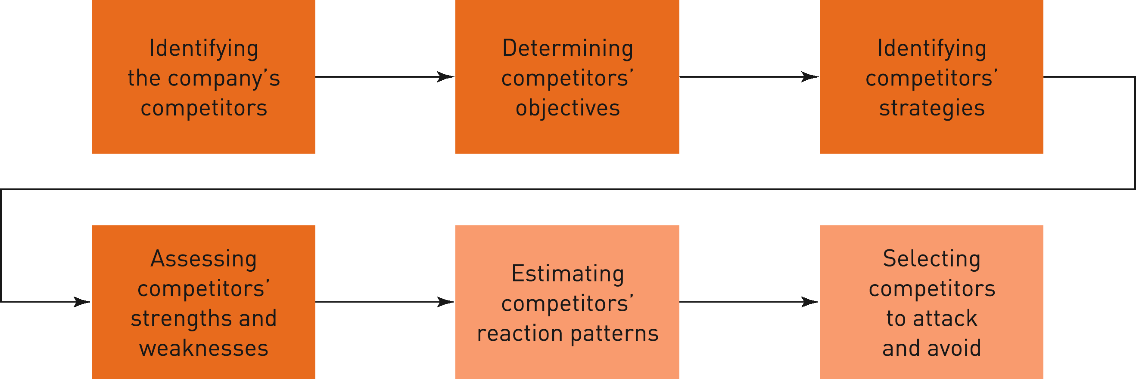
Competitive Strategy 2
Figure 12.1 Steps in analysing competitors

Slide 98
Identify the company’s competitors
The more that one firm’s strategy resembles another firm’s strategy, the more they compete.
  In most industries competitors sort themselves into groups that pursue different strategies.
A strategic group is a group of firms in an industry following the same or similar strategy.
  Competition is intense within the strategic group and also with other competing strategic groups of different composition.
Companies need to know each other’s product quality, features and strategies.
Competitive strategies are those that strongly position the company against competitors and that will give the company the strongest possible strategic advantage.

Slide 99
Selecting competitors to attack and avoid
Assessing competitors strengths & weaknesses
Resources and capabilities will determine whether an organisation will reach their goals.
Benchmarking is an effective mechanism for gauging the strengths of the competition and to find ways to improve quality and performance.
Strong or weak competitors
  Assessment of competitor strengths and weaknesses through the customer value analysis.
Close or distant competitors
  Most companies will compete with those that resemble them the most. A company needs and benefits from competitors.
    Competitors help increase total demand.
    They share costs of market and product development.
    Help legitimise technology.

Slide 100
Competitive Positions
Michael Porter (1980) suggests four basic competitive positioning strategies:
Overall cost leadership
  Lowest costs through greater efficiencies in distribution and production.
Differentiation
  Creation of highly differentiated products and marketing programmes.
Focus
  Focus on serving a few segments very well.
‘Middle-of-the-roaders’
  Undefined strategy.
  Attempt to be all things to all people!
  This is a losing strategy!

Slide 101
Competitive Moves
Market leader
  Firm in an industry that has the largest market share.
Market challenger
  A runner-up firm in an industry that is fighting hard to increase market share.
Market follower
  A runner-up firm in an industry that wants to hold its share without rocking the boat.
Market nicher
  A firm in an industry that serves small segments that the other firms overlook or ignore.

Slide 102
Market leader strategies
Limit competitive pressures by alliances and mergers.
Expand market demand.
Expand market share even if market size remains constant.
Retain strength by reducing costs.
Defend current market share through good defensive and offensive actions.

Slide 103
Market challenger strategies
They can attack the leader and competitors in an aggressive bid for more market share.
They can operate in conjunction with competitors and be market followers.
Defining the strategic objectives and competitors
  Market challengers need to define their position and strategic objective.
  Strategy adopted will depend upon the competition.
  The company must have a clearly defined and attainable objective.

Slide 104
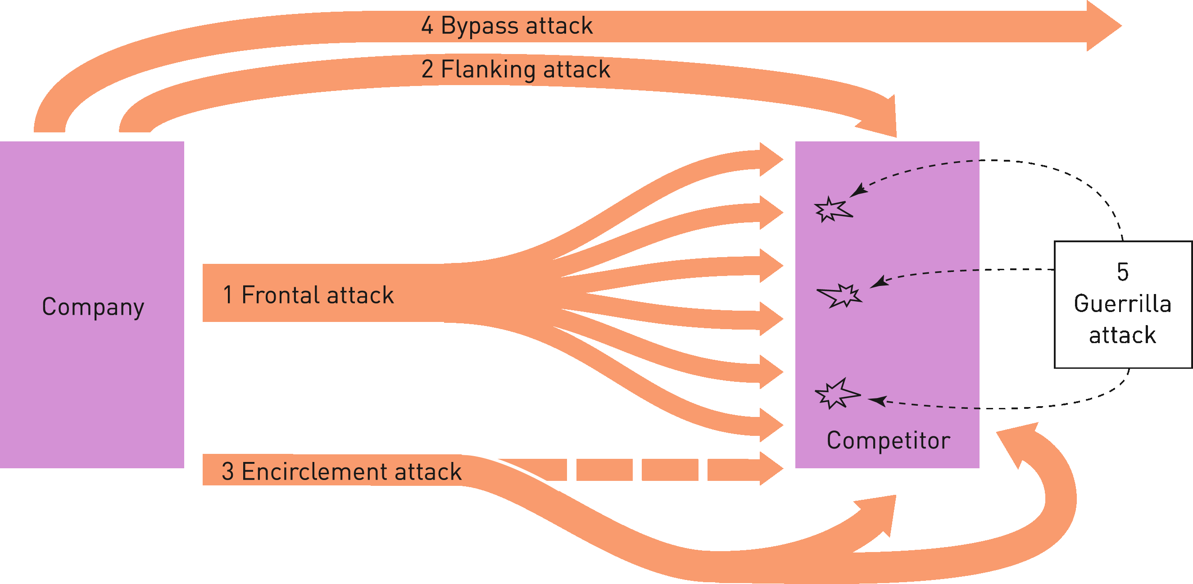
Choosing an attack against the competitors
  1. Frontal attack 2. Flanking attack
  3. Encirclement attack 4. Bypass attack
  5. Guerrilla attack
Figure 12.6 Attack strategies

Slide 105
Choosing an attack against the competitors 1
  Frontal attack
    Attacks the competitor’s strengths rather than its weaknesses.
    Strength and endurance are of paramount importance.
    If there are limited resources a frontal attack is pointless.
  Flanking attack
    Rather than attacking head on, the challenger seeks to identify and attack the competitor’s weak points.
    This strategy is used when there are limited resources.
  Encirclement attack
    Encirclement entails attacking from all sides, so that the competitor has to guard each side.
    Used when the attacker has superior resources and can rapidly break the competitor’s hold on the market.

Slide 106
Choosing an attack against the competitors 1
  Bypass attack
    Challenger bypasses the competitor and targets easier markets.
    Often diversification into unrelated products or new geographic areas.
  Guerrilla attack
    Actions taken by smaller firms against larger ones.
    Continuous guerrilla campaigns can be expensive to defend against and will inevitably lead to a strong challenger wanting to beat the competitor.

Slide 107
Market follower strategies
A market follower can gain many advantages by piggy-backing upon the marketing efforts of the market leader.
  It can copy and improve upon the leader’s products and programmes normally at much lower costs.
  Often highly profitable and the stability of the market safeguards the profits for all players.
  Price wars are avoided and there is no aggressive offensive and subsequent retaliation.
  ‘Cloner’
    Replicates the leader’s strategies
  ‘Imitator’
    Copies some things from the leader but differentiates itself with packaging, advertising, pricing, service.
  ‘Adapter’
    Builds upon the leader’s products and marketing programmes, often improving upon them.

Slide 108
Market nicher strategies
  End-use specialist
    Specialises in one type of end user customer.
  Vertical-level specialist
    Specialises at some level of production or distribution cycle.
  Customer-size specialist
    Concentrates on selling to small, medium or large customers.
  Specific-customer specialist
    Limits selling to one or a few large customers.
  Geographical specialist
    Specific region or locality.
  Product or feature specialist
    Produces specific product or product line.
  Quality-price specialist
    Operates at the low or high end of the market.
  Service specialist
    Offers services not available from other firms.

Slide 109
Segmentation
Segmentation
Targeting
Targeting
Positioning
Positioning
Marketing Mix Formulation
Marketing Mix Formulation

Slide 110
WEEK 7

Slide 111
Marketing Planning S.O.S.T.A.C
T Tactics
how do we get there – individual tactical tools?
Tactics can be defined as the individual steps we need to take our objectives achieved.
Tactics are the details of strategy.
Tactics are driven by strategy.

Slide 112
Marketing Mix
Marketing mix is defined as the set of controllable tactical marketing tools that the firm blends to produce the response it wants in the target market.
The marketing mix consists of everything the firm can do to influence the demand for its product.
The marketing mix is also known as the ‘Four Ps’: Product, Price, Place and Promotion.
Kotler, Armstrong, Saunders and Wong (2001: 97)

Slide 113
Four P’s
Price levels, credit terms, price changes, discounts etc.
Features, packaging, quality, range, etc.
Price
Product
The
Marketing
Mix
Advertising, publicity, sales promotion, personal selling, etc.
Inventory, channels of distribution, number of intermediaries
Place
Promotion

Slide 114
Seven P’s
Physical Evidence
Price
Product
The
Marketing
Mix
People
Process
Place
Promotion

Slide 115
What is a product?
Anything tangible or intangible that, through the exchange process, satisfies consumer or business customer needs.
Product is anything that can be offered to a market for attention, acquisition, use, or consumption and that might satisfy a want or a need.
A product is a good or service.

Slide 116
PRODUCT
Attributes
Benefits
Support Services
Product variety
Quality
Design
Features
Brand name
Packaging
Styling
Size & color varieties
Performance
Image
Pre-sales services
Delivery
Installation
After-sales service
Warranties

Slide 117
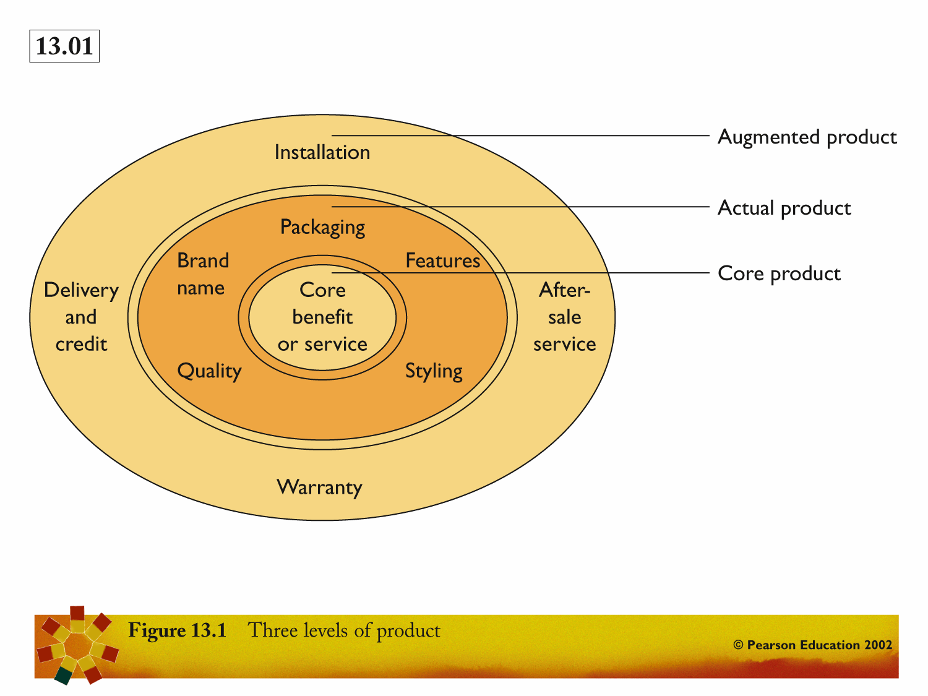

Slide 118
Levels of product
Core product
  problem solving service or core benefits that consumers are really buying when they obtain a product.
Actual product
  incorporates the quality, features and design, brand name, packaging and other attributes that combine to deliver core product benefits.
Augmented product
  incorporates the consumer services and benefits built around the core and actual products.

Slide 119
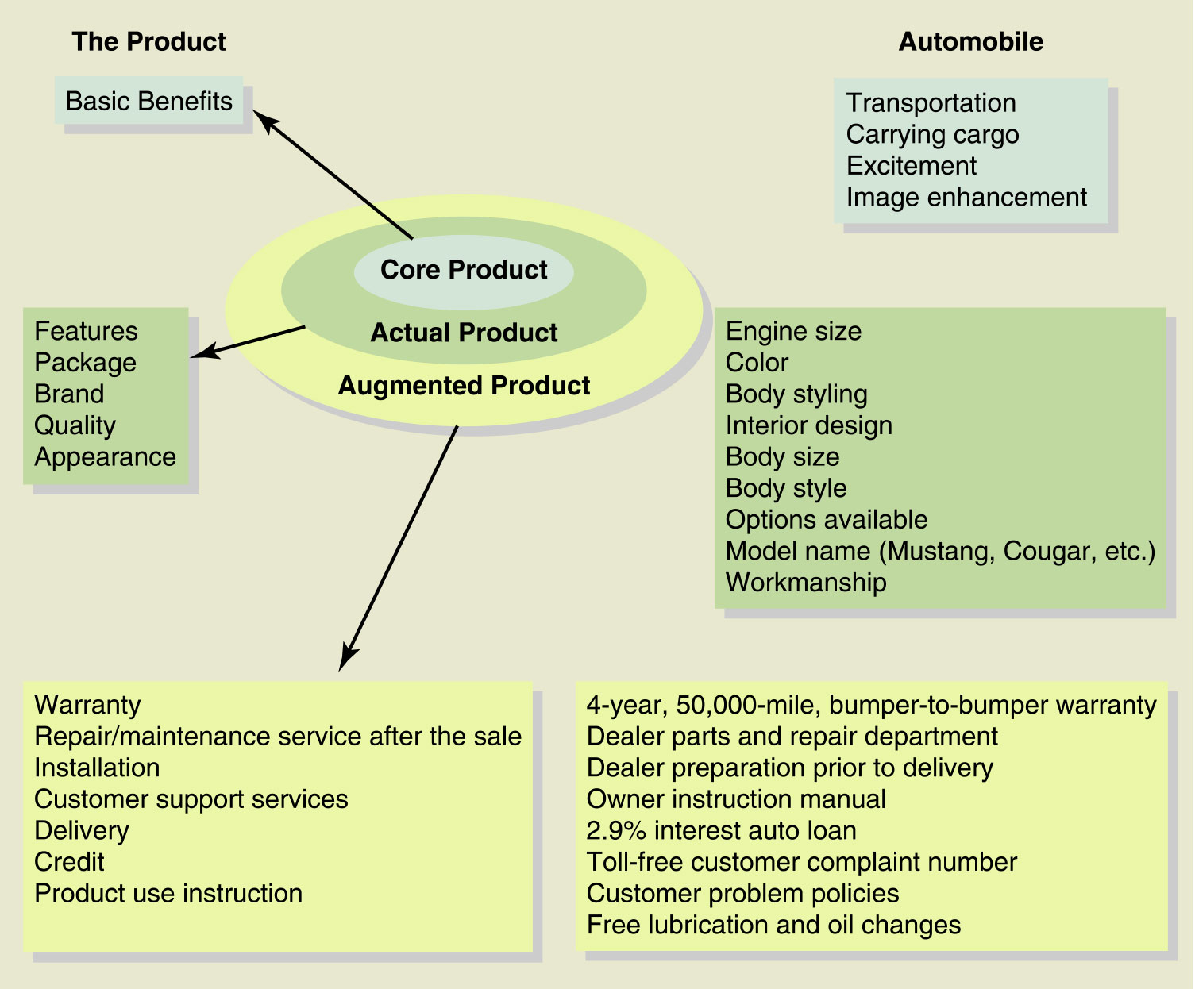

Slide 120
Classification of products? 1
High Involvement Decisions
Durable Goods
Provide Long-Term Benefits
(cars, furniture, appliances)
Nondurable Goods
Provide Short-Term Benefits
(newspapers, food)
High Involvement Decisions

Slide 121
Classification of products? 2
Consumer Products
Industrials Products

Slide 122
Classification of products? 3
How consumers shop for the product?
Convenience Products
Shopping Products
Specialty Products
Unsought Products
Frequently purchased with little effort
Low priced
Must be convenient
Staples, impulse, emergency
Considerable time & effort in selection
Gathering info and comparing alternatives
on suitability, quality, price and style.
e.g. Clothing, appliances, furniture
Products with unique characteristics that are important to buyer
Branding issue (i.e. Mercedes)
Significant purchase efforts
e.g. Luxury goods
Little awareness or interest until need arises
Require much advertising &
personal selling
e.g. Retirement plans, insurance

Slide 123
Classification of products? 4
Classification of Convenience Products
Staples
Impulse Products
Emergency Products
basic or necessary items that are available almost everywhere.
e.g. milk, bread, gas etc.
products that people often buy on the spur of the moment.
e.g. magazines, gum, candy etc.
products that people purchase when we are in direct need.
e.g. Bandages, umbrella etc.

Slide 124
Industrial Products
Products bought for further processing or the purposes of resale.
  Distinction based upon the purpose for which the product is purchased.
Materials and parts
  Raw materials.
  Manufactured materials and parts.
Capital items
  Installations.
  Accessory equipment.
Supplies and services
  Electricity to power the machines making shirts.

Slide 125
Branding
A name, term, sign, symbol or design, or a combination of these, intended to identify the goods or services of one seller or group of sellers and to differentiate them from the competitors.
Benefits for consumers
    Brand names tell the buyer about the quality of the product.
    Brand names increase shopper efficiency.
    Brand names alert consumers to products that might benefit them.

Slide 126
Branding 2
Advantages for suppliers
    Brand name makes it easier for the supplier to process orders and track down problems.
    The supplier’s brand name and trademark provide legal protection for unique production features that might otherwise be copied by the opposition.
    Branding enables the supplier to attract a loyal and profitable set of customers.
    Branding helps suppliers segment markets.

Slide 127
Branding 3
Powerful marketing mechanism
    Leads to higher and more consistent product quality.
    Increases innovation by giving producers an incentive to look for more new features that can be safeguarded by the patent.
    Branding results in more product variety and choice for consumers.
    Branding provides consumer information about products and where to find them.

Slide 128
Aspects of brand positioning
Attributes
  Provides a basic position for the brand based upon its features.
Benefits
  Customers buy benefits not features. These features must be translated into functional and emotional benefits.
Values
  The brand reflects the values of the buyer.
Culture
  The brand represents the culture of the organisation and product.
Personality
  Each brand has a personality and the brand will attract people whose actual or desired self-images match the brand’s image.

Slide 129
Brand name selection
A good name contributes significantly to the success of a brand.
Given the global market, great care needs to be taken regarding the translation of the brand name as illustrated:
Desirable qualities of a brand name
Should suggest something about the product’s features and benefits.
Easy to pronounce, recognise and remember.
Brand name must be distinctive.
Must translate easily and accurately into other major languages.
Must be capable of registration and legal protection.
  Once selected, the brand name needs to be legally protected and registered with the appropriate Trade Marks Register.

Slide 130
Brand Sponsorship
Manufacturer’s brand (national brand)
  Brand created and owned by the producer of the product or service.
Private brand (middleman, distributor or store brand)
  A brand created and owned by a reseller of a product or service.
Licensed brand
  A product or service using a brand name offered by the brand owner to the licensee for an agreed fee or royalty.
Co-brand
  The practice of using the established brand names of two different companies on the same product.

Slide 131
Brand Management
Every customer touch-point must be committed to customer service excellence and to the safeguarding and development of the brand.
Re-branding of brands is an expensive and long process not entered into lightly and often associated with mergers and acquisitions.

Slide 132
Packaging
  Innovative and attractive packaging to gain the attention of the consumer.
  Packaging is central to the marketing considerations and the packaging concept should illustrate what the package should be or do for the product.
    Protection of contents
    Design and presentation
    Colour, trade marks etc.
    Tamper-proof packaging

Slide 133
Labeling
  Identifies the product
  Conforms to legal requirements as in the case of medical products
  Describes the key features of the product
  Promotes the product through attractiveness
  Grades the quality of the product
  Unit pricing
  Open dating
  Nutritional labelling

Slide 134
Packaging & Labeling
Competitive Advantage
Product
Safety
Sales Tasks
Packaging
Labeling
Identifies
Promotes
Describes

Slide 135
WEEK 8

Slide 136
New Product Development

Slide 137
Major stages in new product development
Marketing
Strategy
Business
Analysis
Concept
Development
and Testing
Product
Development
Idea
Screening
Test
Marketing
Idea
Generation
Commercialization

Slide 138
Step:1 Idea Generation
Idea Generation is the Systematic Search for New Product Ideas Obtained Internally From Employees and Also From:
Customers
Competitors
Distributors
Suppliers

Slide 139
Step:2 Idea Screening
Process to spot good ideas and drop poor ones as soon as possible.
Many companies have systems for rating and screening ideas which estimate:
  Market Size
  Product Price
  Development Time & Costs
  Manufacturing Costs
  Rate of Return
Then, the idea is evaluated against a set of general company criteria.

Slide 140
1. Develop New Product Ideas
into Alternative Detailed
Product Concepts
Step:3 Concept Development
2. Concept Testing - Test the
New Product Concepts with
Groups of Target Customers
Product Image is the Way Consumers Perceive an Actual or Potential Product
3. Choose the One That Has the
Strongest Appeal to Target
Customers

Slide 141
Step:4 Marketing Strategy
Part One Describes Overall:
Target Market
Planned Product Positioning
Sales & Profit Goals
Market Share
Part Two Describes First-Year:
Product’s Planned Price
Distribution
Marketing Budget
Part Three Describes Long-Term:
Sales & Profit Goals
Marketing Mix Strategy

Slide 142



Business Analysis
Review of Product Sales, Costs,
and Profits Projections to See if
They Meet Company Objectives
Step:5 Business Analysis
Step: 6 Product Development
If No, Eliminate
Product Concept
If Yes, Move to
Product Development

Slide 143
Step:7 Test Marketing (a)
Test Marketing is the Stage Where the Product and Marketing Program are Introduced into More Realistic Market Settings.
Budget Levels
Product
Packaging
Positioning
Branding
Advertising
Elements that May be Test Marketed by a Company
Pricing
Distribution

Slide 144
Step:7 Test Marketing (b)
Standard
Test Market
Full marketing campaign
in a small number of
representative cities.
Controlled
Test Market
A few stores that have
agreed to carry new
products for a fee.
Simulated
Test Market
Test in a simulated
shopping environment
to a sample of
consumers.

Slide 145
Step:8 Commercialization
Commercialization is the Introduction of the New Product into the Marketplace.
When is the
Right Time to
Introduce
Product?
Where to
Launch a
New
Product?

Slide 146
Introduction Stage of the PLC
Summary of Characteristics, Objectives, & Strategies
Sales
Low sales
Costs
High cost per customer
Profits
Negative or low
Marketing Objectives
Create product awareness and trial
Product
Offer a basic product
Price
Usually is high; use cost-plus formula
Distribution
High distribution expenses
Advertising
Build product awareness among early adopters and dealers

Slide 147
Growth Stage of the PLC
Summary of Characteristics, Objectives, & Strategies
Sales
Rapidly rising sales
Costs
Average cost per customer
Profits
Rising profits
Marketing Objectives
Maximize market share
Product
Offer new product features, extensions, service, and warranty
Price
Price to penetrate market
Distribution
Increase number of distribution outlets
Advertising
Build awareness and interest in the mass market

Slide 148
Maturity Stage of the PLC
Summary of Characteristics, Objectives, & Strategies
Sales
Peak sales
Costs
Low cost per customer
Profits
High profits, then lower profits
Marketing Objectives
Maximize profits while defending market share
Product
Diversify brand and models
Price
Price to match or best competitors
Distribution
Build more intensive distribution
Advertising
Stress brand differences and benefits

Slide 149
Maturity Stage of the PLC
Maturity Stage Product Defense Strategies
Market
Modification
Product
Modification
Marketing
Mix
Modification

Slide 150
Decline Stage of the PLC
Summary of Characteristics, Objectives, & Strategies
Sales
Declining sales
Costs
Low cost per customer
Profits
Declining profits
Marketing Objectives
Reduce expenditure and maintain, reposition, harvest or drop the product
Product
Phase out weak items
Price
Cut price
Distribution
Go selective: phase out unprofitable outlets
Advertising
Reduce to level needed to retain
hard-core loyal customers

Slide 151
WEEK 10

Slide 152
What is Price?
Price is the value that customers give up or exchange to obtain a desired product.
Payment may be in the form of:
  money
  service or goods (bartering)
  favors
  votes
  or anything else that has value to the other party
Price is the sum of all the values that consumers exchange for the benefits of having or using the product or service.
Price has been the major factor affecting buyer choice; nonprice factors have become increasingly important in buyer-choice behavior.
Price is the only element in the marketing mix that produces revenues; all others represent costs.

Slide 153
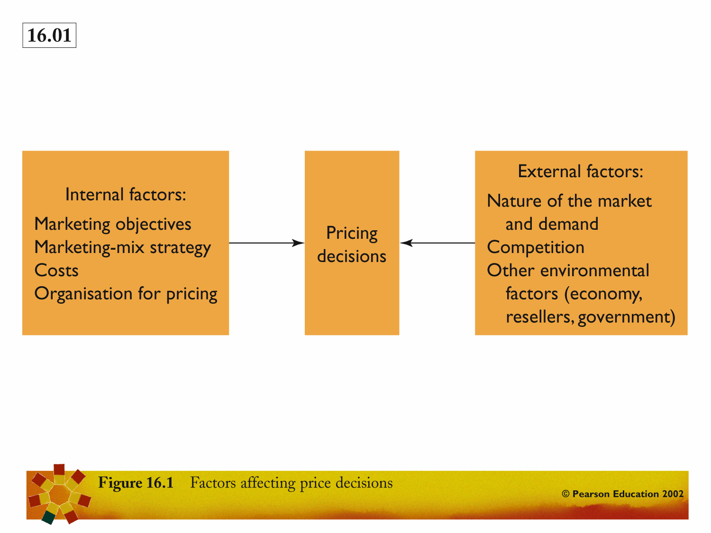

Slide 154
Factors affecting pricing decisions:
Marketing objectives
Survival
Low Prices to Cover Variable Costs and
Some Fixed Costs to Stay in Business.
Marketing
Objectives
Current Profit Maximization Choose the Price that Produces the Maximum Current Profit, Etc.
Market Share Leadership
Low as Possible Prices to Become
the Market Share Leader.
Product Quality Leadership
High Prices to Cover Higher
Performance Quality and R & D.

Slide 155
Factors affecting pricing decisions:
Marketing mix
Product Design
Nonprice
Positions
Price
Distribution
Promotion

Slide 156
Factors affecting pricing decisions:
Cost factor
Fixed Costs
(Overhead)
Costs that don’t
vary with sales or
production levels.
Executive Salaries, Rent
Variable Costs
Costs that do vary
directly with the
level of production.
Raw materials
Total Costs
Sum of the Fixed and Variable Costs for a Given
Level of Production

Slide 157
Market and
Demand
External Factors affecting pricing decisions
Competitors’ Costs,
Prices, and Offers
Other External Factors
Economic Conditions
Reseller Needs
Government Actions
Social Concerns

Slide 158
Market & Demand Factors affecting pricing decisions
Pricing in Different Types of Markets
Pure Competition
Many Buyers and Sellers
Who Have Little
Effect on the Price
Pure Monopoly
Single Seller
Monopolistic
Competition
Many Buyers and Sellers
Who Trade Over a
Range of Prices
Oligopolistic
Competition
Few Sellers Who Are
Sensitive to Each Other’s
Pricing/ Marketing
Strategies

Slide 159
Demand Curve & Price Elasticity of Demand
A Demand Curve is a Curve that Shows the Number of Units the Market Will Buy in a Given Time Period at Different Prices that Might be Charged.
Price Elasticity Refers to How Responsive Demand Will be to a Change in Price.
Price Elasticity of Demand = % Change in Quantity Demanded
% Change in Price

Slide 160
Market & Demand Factors affecting pricing decisions
A. Inelastic Demand -
Demand Hardly Changes With
a Small Change in Price.
Price
P₂
P₁
Q₂
Q₁
Quantity Demanded per Period
B. Elastic Demand -
Demand Changes Greatly With
a Small Change in Price.
Price
P’₂
P’₁
Q₂
Q₁
Quantity Demanded per Period

Slide 161
Cost-based Pricing
Certainty About Costs
Cost-Plus Pricing is an Approach That Adds a Standard Markup to the Cost of the Product.
Simplest Pricing Method
Pricing is Simplified
Price Competition Is Minimized
Ignores Current Demand & Competition
Much Fairer to Buyers & Sellers

Slide 162
Breakeven Analysis or Target Profit Pricing
Tries to Determine the Price at Which a Firm Will Break Even or Make a Certain Target Profit.
Total Revenue
12
10
Target Profit
($2 million)
Cost in Dollars (millions)
8
6
Total Cost
4
Fixed Cost
2
200
400
600
800
1,000
Sales Volume in Units (thousands)

Slide 163
Cost based Vs Value based Pricing
Product
Customer
Cost
Value
Cost-Based Pricing
Value-Based Pricing
Price
Price
Value
Cost
Customers
Product

Slide 164

Setting Prices
Competition based Pricing
Going-Rate
Company Sets Prices Based on What
Competitors Are Charging.
Sealed-Bid
Company Sets Prices Based on
What They Think Competitors
Will Charge.
?
?

Slide 165
Pricing Considerations and Strategies

Slide 166
New Product Pricing Strategies
Market Skimming
Setting a High Price for a New Product to “Skim” Maximum Revenues from the Target Market.
Results in Fewer, But More Profitable Sales.
Use Under These Conditions:
  Product’s Quality and Image Must Support Its Higher Price.
  Costs Can’t be so High that They Cancel the Advantage of Charging More.
  Competitors Shouldn’t be Able to Enter Market Easily and Undercut the High Price.

Slide 167
New Product Pricing Strategies
Use Under These Conditions:
  Market Must be Highly Price-Sensitive so a Low Price Produces More Market Growth.
  Production/ Distribution Costs Must Fall as Sales Volume Increases.
  Must Keep Out Competition & Maintain Its Low Price Position or Benefits May Only be Temporary.
Market Penetration
Setting a Low Price for a New Product in Order to “Penetrate” the Market Quickly and Deeply.
Attract a Large Number of Buyers and Win a Larger Market Share.

Slide 168


Product Mix-Pricing Strategies:
Product Line Pricing
Involves setting price steps between various products in a product line based on:
  Cost differences between products,
  Customer evaluations of different features, and
  competitors’ prices.

Slide 169


Product Mix- Pricing Strategies
Optional-Product
  Pricing optional or accessory products sold with the main product. i.e camera bag.
Captive-Product
  Pricing products that must be used with the main product. i.e. film.

Slide 170
Product Mix- Pricing Strategies
By-Product
  Pricing low-value by-products to get rid of them and make the main product’s price more competitive.
  i.e. sawdust, Zoo Doo
Product-Bundling
  Combining several products and offering the bundle at a reduced price.
  i.e. theater season tickets.

Slide 171
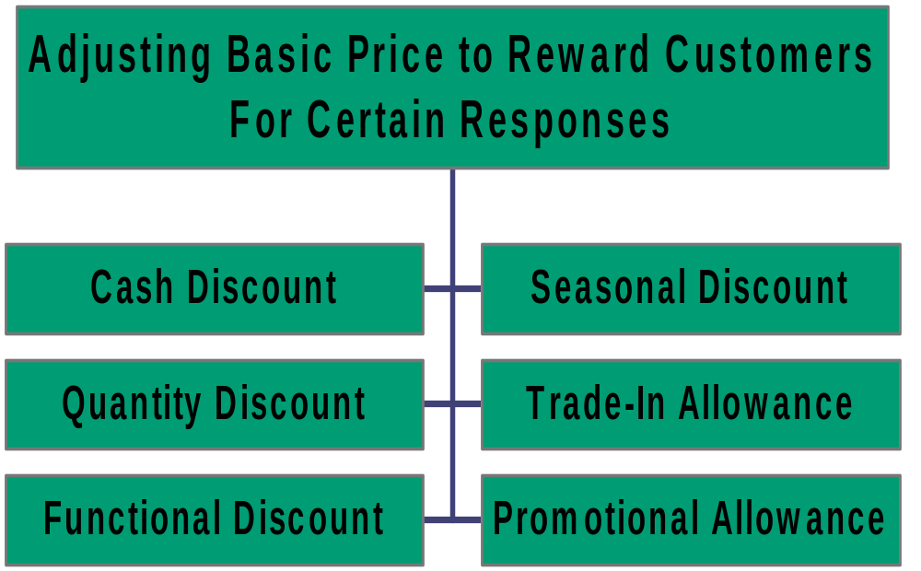
Discount and Allowance Pricing

Slide 172
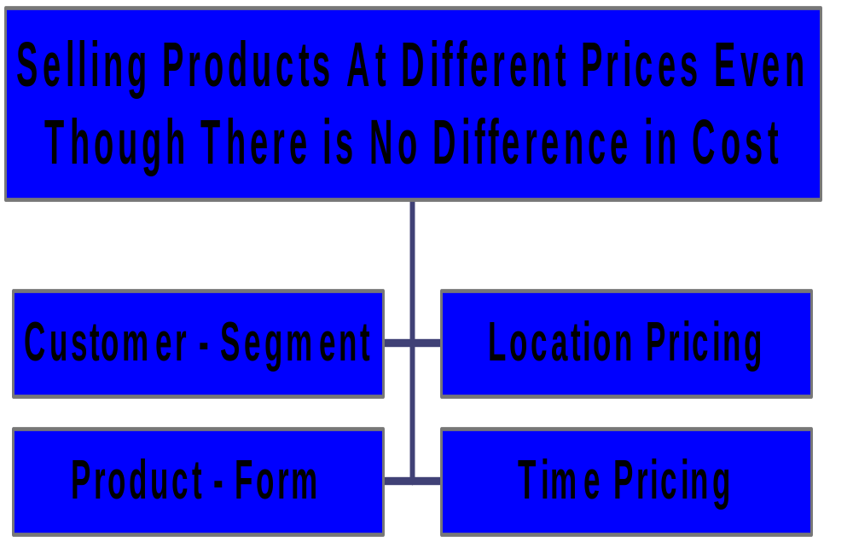
Segmented Pricing

Slide 173

Psychological Pricing
Considers the psychology of prices and not simply the economics.
Customers use price less when they can judge quality of a product.
Price becomes an important quality signal when customers can’t judge quality; price is used to say something about a product.
Value $22.00
Sale $14.99

Slide 174
Promotional Pricing
Loss Leaders
Special-Event Pricing
Cash Rebates
Temporarily Pricing Products Below List Price to Increase Short-Term Sales Through:
Low-Interest Financing
Longer Warranties
Free Merchandise
Discounts

Slide 175
Other Price Adjustment Strategies
Geographical Pricing
Adjusting Prices to Account
for the Geographical Location
of Customers.
i.e. FOB-Origin, Uniform-
Delivery, Zone Pricing, Basing
Point, & Freight-Absorption.
Adjusting Prices for
International Markets.
Price Depends on Costs,
Consumers, Economic
Conditions, Competitive
Situations & Other Factors.
International Pricing

Slide 176
Initiating Price Changes
Price Cuts
Price Increases
Why?
Excess Capacity
Falling Market Share
Dominate Market Through Lower Costs
Why?
Cost Inflation
Overdemand: Company Can’t Supply All Customer’s Needs

Slide 177
Reactions to Price Changes
Being Replaced by Newer Models
Number of Firms is Small
Price Cuts Are Seen by Buyers As:
Competitors Reactions When:
Current Models Are Not Selling Well
Product is Uniform
Company is in Financial Trouble
Buyers are Well Informed
Quality Has Been Reduced
Price Comes Down Further

Slide 178
WEEK 11

Slide 179
Distribution Channels & Logistics Management

Slide 180
Issues concerning distribution channels
What Role Does
Physical Distribution
Play in Attracting
and Satisfying
Customers?
What is the Nature
Of Distribution
Channels?
How do Channel
Firms Interact and
Organize to do the
Work of the
Channel?
What Problems do
Companies Face in
Designing and
Managing Their
Channels?

Slide 181
What is a distribution channel?
A set of interdependent organizations (intermediaries) involved in the process of making a product or service available for use or consumption by the consumer or business user.
Marketing Channel decisions are among the most important decisions that management faces and will directly affect every other marketing decision.

Slide 182
Why are marketing intermediaries used?
The use of intermediaries results from their greater efficiency in making goods available to target markets.
Offer the firm more than it can achieve on it’s own through the intermediaries:
  Contacts,
  Experience,
  Specialization,
  Scale of operation.
Purpose: match supply from producers to demand from consumers.

Slide 183
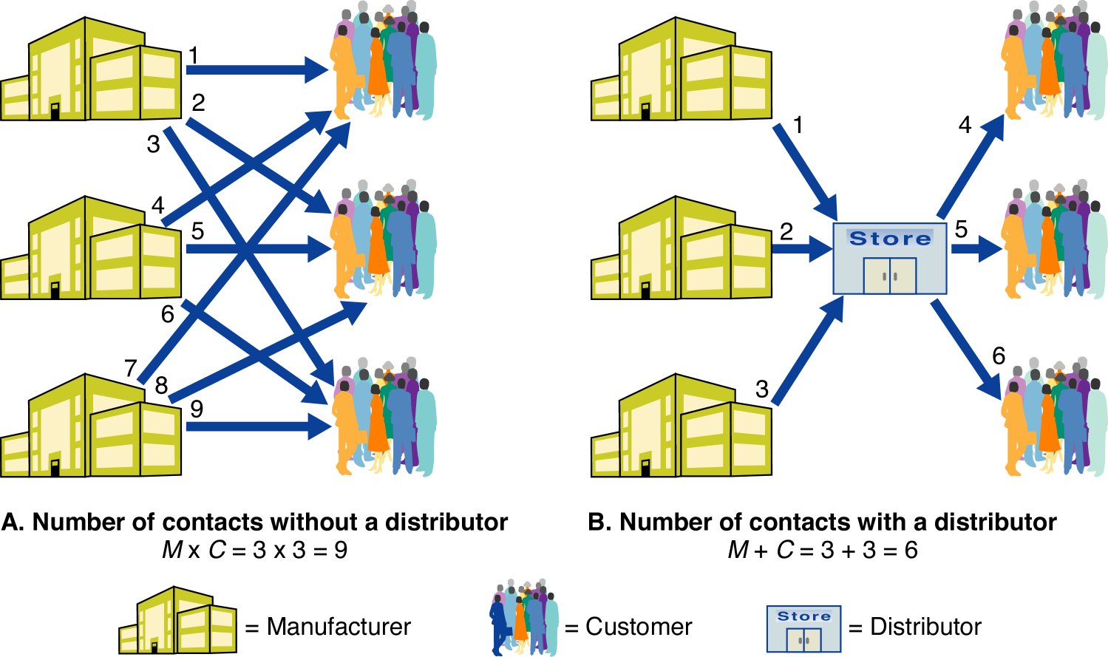
How a marketing intermediary
reduces the no. of channel transactions?

Slide 184
Distribution Channel Functions?
These Functions Should be Assigned to the Channel Member Who Can Perform Them Most Efficiently and Effectively to Provide Satisfactory Assortments of Goods and Services to Target Customers.
Risk Taking
Information
Financing
Promotion
Physical
Distribution
Contact
Negotiation
Matching

Slide 185
Number of Channel Levels
Channel Level - Each Layer of Marketing Intermediaries that Perform Some Work in Bringing the Product and its Ownership Closer to the Final Buyer.
M
C
Channel 1
Direct Channel
M
R
C
Channel 2
Indirect Channel
M
W
R
C
Channel 3
M
W
J
R
C
Channel 4

Slide 186
Conventional Marketing Channel Vs Vertical Marketing System
Conventional
Marketing
Channel
Vertical
Marketing
System
Manufacturer
Manufacturer
Retailer
Vertical Marketing System
The channel systems consisting of horizontally coordinated and vertically aligned establishments that are professionally managed and centrally coordinated to achieve optimum operating economies and maximum market impact.
Wholesaler
Wholesaler
Retailer
Consumer
Consumer

Slide 187
Analyzing Consumer Service Needs
Setting Channel Objectives & Constraints
Identifying Major Alternatives
Channel Design Decisions
Evaluating the Major Alternatives
Designing International Distribution Channels
Intensive
Distribution
Selective
Distribution
Exclusive
Distribution

Slide 188
Major Logistics Functions
Costs
Minimize Costs of
Attaining Logistics
Objectives
Order Processing
Received
Processed
Shipped
Logistics
Functions
Warehousing
Storage
Distribution
Automated
Transportation Rail, Truck, Water, Pipeline, Air, Intermodal
Inventory
When to order
How much to order
Just-in-time

Slide 189
Transportation Modes
Rail
Nation’s largest carrier, cost-effective
for shipping bulk products, piggyback
Truck
Flexible in routing & time schedules, efficient
for short-hauls of high value goods
Water
Low cost for shipping bulky, low-value,
non perishable goods, slowest form
Pipeline
Ship petroleum, natural gas, and chemicals
from sources to markets
Air
High cost, ideal when speed is needed or
distance markets have to be reached

Slide 190
Choosing Transportation Modes
Checklist for Choosing
Transportation Modes
1. Speed
2. Dependability
3. Availability
4. Costs
5. Others

Slide 191
Retailing & Wholesaling

Slide 192
What is Retailing?
Includes all the activities Involved in Selling Goods or Services Directly to Final Consumers for Their Personal, Nonbusiness Use.
Retailing can be done in stores (store retailing) or out of a store (nonstore retailing) such as:
  Direct mail,
  Catalogs,
  Telephone,
  Home shopping shows,
  Internet.

Slide 193
Classification of Retailing
Product Line
Store Description
Specialty Stores
Narrow Product Line, Deep Assortment i.e. The Limited or Athlete’s Foot
Department Stores
Wide Variety of Product Lines i.e. Clothing, Home Furnishings, Saks Fifth Avenue
Supermarkets
Wide Variety of Food, Laundry, & Household Products i.e. Kroger
Convenience Stores
Limited Line of High-Turnover Convenience Goods i.e. 7-Eleven
Superstores
Large Assortment of Routinely Purchased Food & Nonfood Products i.e. Toys R Us
Discount Stores
Standard Merchandise at Lower Prices
i.e. Wal-Mart
Off-Price Retailers
Changing Collection of Higher-Quality Goods at a Reduced Price i.e. T.J. Maxx
Warehouse Clubs
Limited Selection of Brand-Name Grocery Items, Appliances, Etc. i.e. Sam’s Club

Slide 194
Classification of Retailing
Relative Prices
Higher Prices and Offer Higher-Quality Goods
and Customer Service
Regular Prices and Offer Normal-Quality Goods
and Customer Service
Low Prices and Offer Lower-Quality Goods
and Customer Service
Discount
Stores
“Off-Priced”
Retailers
Catalog
Showrooms

Slide 195
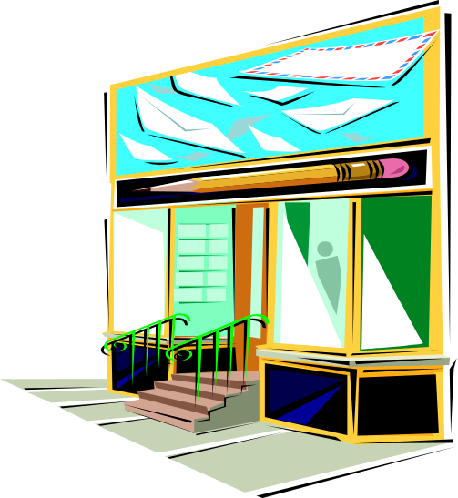
Classification of Retailing
Retail Organization
Merchandising
Conglomerates
Corporate
Chain
Franchise
Organizations
Voluntary
Chain
Retailer
Cooperatives

Slide 196
New Retail Forms and Shortening Retail Lifecycle
Growth of Nonstore Retailing
Increasing Intertype Competition
Rise of Megaretailer
Future of Retailing
Growing Importance of Retail Technology
Global Expansion of Major Retailers
Retail Stores as “Communities” or “Hangouts”

Slide 197
What is Wholesaling?
All the activities involved in selling goods and services to those buying for resale or business use.
Wholesaler - those firms engaged primarily in wholesaling activity.
Wholesalers buy mostly from producers and sell mostly to:
  Retailers,
  Industrial consumers, and
  Other wholesalers.

Slide 198
Why are wholesalers used?
Wholesalers are Often Better at Performing One or More of the Following Channel Functions:
Management
Services & Advice
Selling and
Promoting
Market
Information
Buying and
Assortment Building
Wholesaler
Functions
Risk Bearing
Bulk Breaking
Financing
Warehousing
Transportation

Slide 199
Types of wholesalers
Merchant Wholesaler
Independently Owned
Business that Takes Title to the
Merchandise it Handles.
Manufacturers’ Sales Branches and Offices
Wholesaling by Sellers or Buyers Themselves
Rather Than Through
Independent
Wholesalers.
Brokers/ Agents
They Don’t Take Title to
the Goods, and They
Perform Only a Few
Functions.

Slide 200
WEEK 12

Slide 201
Promotion
Integrated Marketing Communications

Slide 202
Integrated Marketing Communications
Integrated Marketing Communications (IMC) is the concept under which the company integrates and coordinates its communications channels to deliver a clear and consistent message about the organisation and its products.

Slide 203
Marketing Communications Mix Promotional Mix
Advertising
Any paid form of non-personal presentations and promotion of ideas, goods, or services by an identified sponsor.
Personal
Selling
Personal presentation by the firm’s sales force for the purpose of making sales and building customer relationship.
Sales
Promotion
Short term incentives to encourage the purchase or sale of a product or service.
Building good relations with the companies various publics by obtaining favorable publicity, building up a good corporate image, and handling or hearing of unfavorable rumors, stories and events.
Public
Relations
Direct
Marketing
Direct communications with carefully targeted individual consumers to obtain an immediate response, and cultivate lasting customer relationship.

Slide 204
A view of communications process
Marketers View Communications as the Management of the Customer Relationship Over Time Through the Following Stages:
Preselling
Selling
Post-
Consumption
Consuming

Slide 205
Step 1. Identifying the Target Audience
Step 2. Determining the Communication Objectives
Buyer Readiness Stages
Steps in developing effective communications 1.
Step 3. Designing a Message
Step 4. Choosing Media
Step 5. Selecting the Message Source
Step 6. Collecting Feedback

Slide 206
Setting the Total Promotion Budget
One of the Hardest Marketing Decisions Facing a Company is How Much to Spend on Promotion.
Affordable
Based on What the
Company Can Afford
Percentage of Sales
Based on a Certain Percentage
of Current or Forecasted Sales
Objective-and-Task
Based on Determining
Objectives & Tasks, Then
Estimating Costs
Competitive-Parity
Based on the Competitor’s
Promotion Budget

Slide 207




Setting the Promotion Mix
Advertising
Reach Many Buyers, Repeat Message Many Times, Impersonal, Expensive
Personal
Selling
Personal Interaction, Relationship Building, Most Expensive Promo Tool
Sales
Promotion
Wide Assortment of Tools, Rewards Quick Response, Efforts Short-Lived
Public
Relations
Very Believable, Dramatize a Company or Product, Underutilized
Direct
Marketing
Nonpublic, Immediate, Customized, Interactive

Slide 208
Setting the Promotion Mix
Strategy Selected Depends on:
Type of Product-Market &
Product Life-Cycle Stage
Push Strategy
Pull Strategy
Strategy that Calls for Spending A Lot on Advertising and Consumer Promotion to Build Up (Pull) Consumer Demand.
Strategy that Calls for Using the Salesforce and Trade Promotion to Push the Product Through the Channels.

Slide 209
Integrating Promotion Mix
Analyze trends – internal and external – that can affect your company’s ability to do business.
Audit the pockets of communications spending through the organization.
Identify all contact points for the company and its brands.
Team up in communications planning.
Create compatible themes, tones, and quality across all communications media.
Create performance measures that are shared by all communications elements.
Appoint a director responsible for the company’s persuasive communications efforts.

Slide 210
Advertising
Any paid form of non-personal presentations and promotion of ideas, goods, or services by an identified sponsor.
Advertising is centuries old.
U.S. advertisers spend in excess of $212 billion each year; worldwide spending exceeds $414 billion.
Advertising is used by:
  Business firms,
  Nonprofit organizations,
  Professionals, and
  Social agencies.

Slide 211
Major Advertising Decisions
Message Decisions
Message Strategy
Message Execution
Objectives Setting
Communication objectives
Sales Objectives
Budget Decisions
Affordable Approach
Percent of sales
Competitive parity
Objective and task
Campaign Evaluation
Communication Impact
Sales Impact
Media Decisions
Reach, Frequency, Impact
Major Media Types
Specific Media Types
Media Timing

Slide 212

Setting Advertising Objectives
Informative Advertising
Inform Consumers or
Build Primary Demand
i.e CD Players
Persuasive Advertising
Build Selective Demand
i.e Sony CD Players
Advertising Objective
Specific Communication Task
Accomplished with a Specific
Target Audience
During a Specific Period of Time
Comparison Advertising
Compares One Brand to
Another
i.e. Avis vs. Hertz
Reminder Advertising
Keeps Consumers Thinking
About a Product
i.e. Coca-Cola

Slide 213
Setting the Total Promotion Budget
One of the Hardest Marketing Decisions Facing a Company is How Much to Spend on Promotion.
Affordable
Based on What the
Company Can Afford
Percentage of Sales
Based on a Certain Percentage
of Current or Forecasted Sales
Objective-and-Task
Based on Determining
Objectives & Tasks, Then
Estimating Costs
Competitive-Parity
Based on the Competitor’s
Promotion Budget

Slide 214

Setting the advertising budget
Factors to be considered when setting the advertising budget:
  Stage in the product life cycle,
  Market share,
  Competition and clutter,
  Product differentiation.

Slide 215
Developing advertising strategy
Advertising Strategy Consists of Two Major Elements and Companies are Realizing the Benefits of Planning These Two Elements Jointly.
Creating the Advertising
Selecting the Advertising Media
Messages

Slide 216
Plan a Message Strategy
General Message to Be Communicated to Customers
Developing advertising strategy:
Creating Ad Message
Develop a Message
Focus on
Customer Benefits
Creative Concept
“Big Idea”
Visualization or Phrase
Combination of Both
Advertising Appeals
Meaningful
Believable
Distinctive

Slide 217
Developing advertising strategy:
Message Execution
Turning the “Big Idea” Into an Actual Ad to Capture the Target Market’s Attention and Interest.
Testimonial Evidence
Slice of Life
Scientific Evidence
Lifestyle
Typical
Message
Execution
Styles
Technical Expertise
Fantasy
Personality Symbol
Mood or Image
Musical

Slide 218
Step 1. Decide on Reach, Frequency,
and Impact
Step 2. Choosing Among Major Media Types
Media Habits of Target Consumers,
Nature of the Product, Types of Message, Cost
Advertising Strategy:
Selecting Advertising Media
Step 3. Selecting Specific Media Vehicles
Specific Media Within a Given Type, i.e. Magazines.
Must Balance Media Cost Against Media Factors:
Audience Quality & Attention, Editorial Quality
Step 4. Deciding on Media Timing
Scheduling of Advertising Over the Course of a Year
Pattern of Ads: Continuity or Pulsing

Slide 219
Advertising Program Evaluation
Evaluating Advertising
Communication Effects
Is the Ad Communicating Well?
Sales Effects
Is the Ad Increasing Sales?

Slide 220

International Advertising Decisions
Adaptation of Global Advertising
Advertising Media Differ Considerably in Availability and Cost
Regulation in Advertising Practices
Comparison Ads Not Acceptable in All Countries
Programs Must be Matched to Local Cultures and Customs

Slide 221
WEEK 13

Slide 222
Sales Promotion
Short-term incentives to encourage the purchase or sale of a product or service.
Sales promotion can take the form of consumer promotions, business promotions, trade promotions or sales force promotions.
Rapid growth in the industry has been achieved because:
  Product managers are facing more pressure to increase their current sales,
  Companies face more competition,
  Advertising efficiency has declined,
  Consumers have become more deal oriented.

Slide 223
Sales Promotion Objectives
Increase short-term sales or help build long-term market share.
Get retailers to:
  carry new items and more inventory,
  advertise products,
  give products more shelf space, and
  buy product ahead.
In general, sales promotion should focus on consumer relationship building.

Slide 224
Major Consumer Sales
Promotional Tools 1
Sample
Trial amount of a product
Coupons
Savings when purchasing specified products
Cash Refunds
Refund of part of the purchase price
Price Packs
Reduced prices marked on the label or package
Premiums
Goods offered free or low cost as an incentive to buy a product
Advertising
Specialties
Articles imprinted with an advertiser’s name given as gifts

Slide 225
Major Consumer Sales
Promotional Tools 2
Patronage Rewards
Cash or other rewards for the use of a certain product
Point-of-Purchase
Displays and demonstrations that take place at the point of sale
Contests
Consumers submit an entry to be judged
Sweepstakes
Consumers submit their names for a drawing
Game
Presents consumers with something every time they buy

Slide 226
Major Consumer Sales
Promotional Tools 3
Trade-Promotion Objectives
Trade-Promotion Tools
Persuade Retailers or
Wholesalers to Carry a Brand
Discounts
Give a Brand Shelf Space
Allowances
Promote a Brand in
Advertising
Push a Brand to Consumers

Slide 227
Major Consumer Sales
Promotional Tools 4
Business-Promotion Objectives
Business-Promotion Tools
Generate Business Leads
Conventions
Stimulate Purchases
Trade Shows
Reward Customers
Sales Contests
Motivate Salespeople

Slide 228
Public Relations
Building good relations with the companies various publics by obtaining favorable publicity, building up a good corporate image, and handling or hearing of unfavorable rumors, stories and events.
Public relations is used to promote products, people, places, ideas, activities, organizations, and even nations.

Slide 229
Major Public Relation Functions
Press Relations or Agentry
Product Publicity
Public Relations Departments May Perform Any of All of the Following Functions:
Public Affairs
Lobbying
Investor Relations
Development

Slide 230

Major Public Relation Tools
News
Web Site
Speeches
Public Service Activities
Special Events
Corporate Identity Materials
Written Materials
Audiovisual Materials

Slide 231
Personal Selling
‘An interpersonal communication tool which involves face to face activities undertaken by individuals, often representing an organisation, in order to inform, persuade or remind an individual or group to take appropriate action, as required by the sponsor’s representatives’. (Brassington and Pettitt 2000)
Involves Two-Way, Personal Communication Between Salespeople and Individual Customers Whether:
    face to face,
    by telephone,
    through video conferencing,
    or by other means.

Slide 232
Personal selling process
The opening
Need & problem identification
Presentation & demonstration
Dealing with objections
Negotiation
Closing the sale
Follow-up

Slide 233

The Sales Force
"The salespeople employed by a firm to sell its goods or services"
(Collins Dictionary of Business, 1995.)
"The salespeople has become increasingly important as the vital link between the manufacturer and the distributor and user" (Gillam, 1986)

Slide 234
The Role of Sales Force
Personal Selling is effective because salespeople can:
  probe customers to learn more about their problems,
  adjust the marketing offer to fit the special needs of each customer,
  negotiate terms of sale,
  build long-term personal relationships with key decision makers.
The Sales Force serves as a critical link between a company and its customers since they:
  represent the company to customers, and
  represent customers to the company.

Slide 235
Steps in Selling Process
Prospecting
Salesperson Identifies Qualified Potential Customers.
Qualifying
Process of Identifying Good Prospects and Screening Out Poor Ones.
Preapproach
Salesperson Learns as Much as Possible About a Prospective Customer Before Making a Sales Call.
Approach
Salesperson Meets the Buyer and Gets the Relationship Off to a Good Start.
Presentation
Salesperson Tells the Product “Story” to the Buyer Using the Need-Satisfaction Approach.
Handling
Objections
Salesperson Seeks Out, Clarifies, and Overcomes Customer Objections to Buying.
Closing
Salesperson Asks the Customer for an Order.
Follow-Up
Occurs After the Sale and Ensures Customer Satisfaction and Repeat Business.

Slide 236
WEEK 14

Slide 237


Direct Marketing
Direct marketing could be defined as any activity that creates and exploits a direct relationship between you and your customer or prospect on an individual basis. (Drayton Bird)
Most Mass Marketing Involves One-Way Communications Aimed At Consumers.
Direct Marketing Involves Two-Way Interactions With Customers.

Slide 238
Benefits & Growth of Direct Marketing
Convenient
Consumer Relationship Building
Buyers Benefits
Sellers Benefits
Easy & Private
Reduces Costs
Product Access &
Selection
Increases Speed & Efficiency
Abundance of Information
Provides Flexibility
Interactive & Immediate
Global Medium

Slide 239
Mass Marketing Vs
One2One Marketing
Mass Marketing
One-to-One Marketing
Average Consumer
Individual Customer
Customer Anonymity
Customer Profile
Standard Product
Customized Market Offering
Mass Production
Customized Production
Mass Distribution
Individualized Distribution
Mass Advertising
Individualized Message
Mass Promotion
Individualized Incentives
One-Way Message
Two-Way Messages
Economies of Scale
Economies of Scope
Share of Mind
Share of Customer
All Customers
Profitable Customers
Customer Attraction
Customer Retention

Slide 240

Customer Database 1
Customer Databases are an Organized Collection of Comprehensive Data About Individual Customers or Prospects Including:
  Geographic,
  Demographic,
  Psychographic, and
  Behavioral Data.

Slide 241
Customer Database 2
Identifying Prospects
Database Marketing is the Process of Building, Maintaining, and Using Customer Databases and Other Databases for the Purposes of Contacting and Transacting With Customers. How Companies Use Their Databases:
Deciding Which Customers Should
Receive a Particular Offer
Deepening Customer Loyalty
Reactivating Customer Purchases

Slide 242

Forms of Direct Marketing
Face-to-Face
Selling
Online
Marketing
Telemarketing
Kiosk
Marketing
Direct
Mail
Direct-Response
TV Marketing
Catalog

Slide 243
On-line Marketing
Online Marketing is conducted through interactive online computer systems, which link consumers with sellers electronically.
Two types of online marketing channels:
  Commercial Online Services offer information and marketing services to subscribers who pay a monthly fee. (i.e. American Online)
  The Internet (the Net) is the vast global and public web of computer networks.

Slide 244
Limited Consumer Exposure and Buying
Skewed User Demographics and Psychographics
Promise & Challenge of
On-line Marketing
Chaos and Clutter
Security
Ethical Concerns

Slide 245
Integrated Direct Marketing
Direct marketing campaigns that use multiple vehicles and multiple stages to improve response rates and profits.
Marketers seek to improve response rates and profits by adding media and stages that contribute more to additional sales than to additional costs.

Slide 246
An Integrated Direct Marketing
Campaign
Paid ad with a
response channel
Direct Mail
Outbound
Telemarketing
Face-to-face
sales call
Continuing
Communication

Slide 247
Marketing Planning S.O.S.T.A.C
A Action
putting the plan to work - what are the specific actions required for each individual tactical step?
Planning good strategies is only a start towards successful marketing. A brilliant marketing strategy counts for little if the company fails to implement it properly.
Marketing implementation is the process that turns marketing strategies and plans into marketing actions to accomplish strategic marketing objectives. Implementation involves day-to-day activities that effectively put the marketing plan to work.

Slide 248
Marketing Planning S.O.S.T.A.C
A Action
putting the plan to work - what are the specific actions required for each individual tactical step?
Action includes:
Project management
Schedules and deadlines
Meetings and memos
Budget monitoring
Media plan coordination
Phone calls & chasing people
Careful preparation
Constant checking and attention to vast volumes of details.

Slide 249
Marketing Planning S.O.S.T.A.C
C Control
how do we know we have arrived? - measurement, monitoring, reviewing, updating and modifying.
This practise allows higher management to review the results of the plan and spot businesses or products that are not meeting their goals. Corrective action should follow this.
Controlling involves: measurement, monitoring, reviewing, updating and modifying.
How do we know we have arrived?
This final stage is concerned with controlling and measuring the results. To achieve this, we have to go back to the objectives. What exactly has the campaign achieved and to what extent have the objectives been met?
This will allow us to monitor and review our strategic marketing plan and direct possible methods of modification and updating.

Slide 250
Marketing Planning S.O.S.T.A.C
C Control
how do we know we have arrived? - measurement, monitoring, reviewing, updating and modifying.
Control includes:
Allocate Personnel
Budget monitoring
Media plan control
Updating plan
Measuring objectives

Slide 251
Marketing Planning
S.O.S.T.A.C
S Situation Analysis - where are we now?
O Objectives - where do we want to go?
S Strategy - how do we get there – broad direction?
T Tactics - how do we get there - details of strategies (individual tactical tools)?
A Action - putting the plan to work - what are the specific actions required for each individual tactical step?
C Control - how do we know we have arrived? - measurement, monitoring, reviewing, updating and modifying.

